Slide 1
Patrick Marsh A Sun Prairie Rotary Project

Slide 2
Patrick Marsh Project
Establishing a surveyor meander corner in the shape of Wisconsin’s original Point of Beginning
Constructing an additional viewing area for people to come to enjoy the marsh, wetlands and wildlife
Creating informational & educational plaques for visitors
To honor William T (Bill) Wambach, a member of the Sun Prairie Rotary Club, a surveyor, and DOT engineer who was instrumental in the reestablishment and development of Patrick Marsh Wildlife Area and reestablishing Wisconsin’s original Point of Beginning

Slide 3
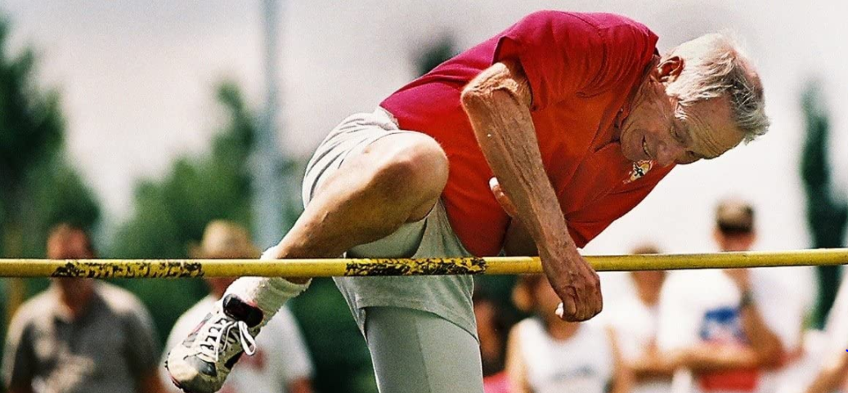
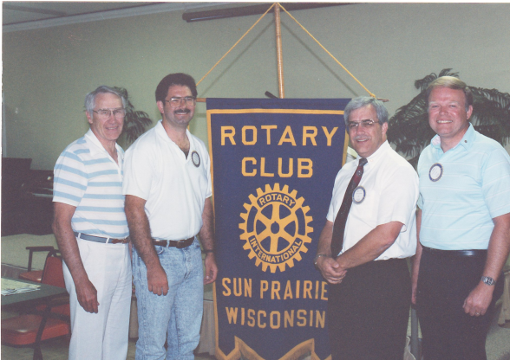
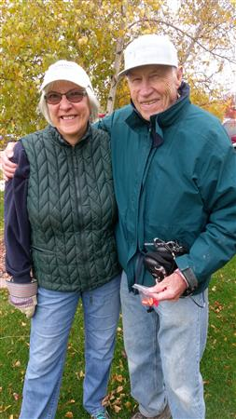
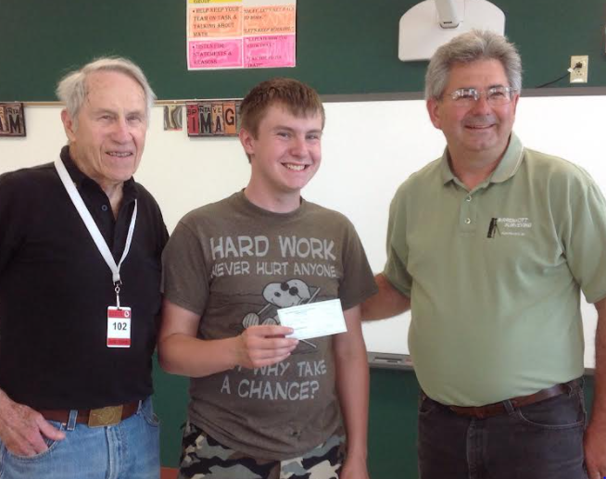
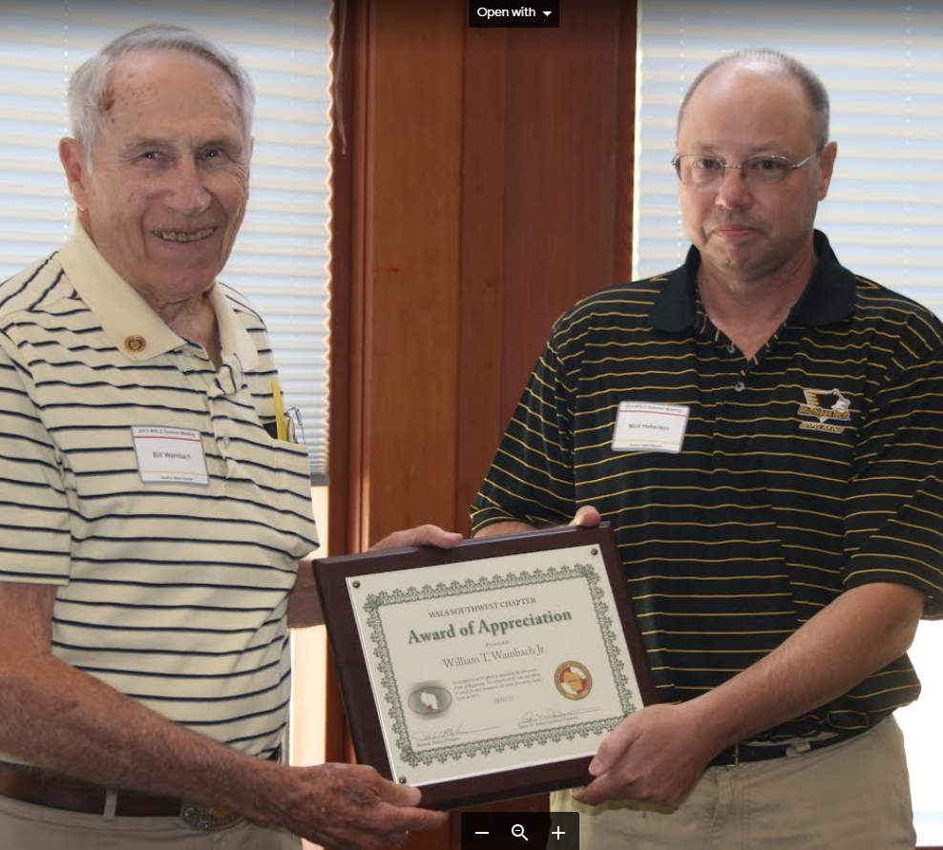
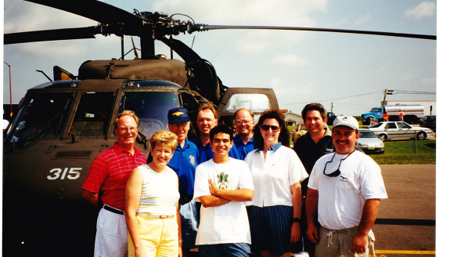
Bill Wambach

Slide 4
Patrick Marsh Project Where do we Stand today
DNR is collaborating with Groundswell Conservancy on land exchanges
Patrick Marsh based on location and other factors really doesn’t fit the DNR wildlife conservation model anymore
Jim Lemke, Real Estate Section Chief of DNR is working with our group and will present to the Natural Resource Board NBR for approval a land exchange proposal
Letters of support are being presented to the NRB in support of the land exchange and the project (~18 letters)

Slide 5
Patrick Marsh History

Slide 6
Patrick Marsh The History
A long dry spell from 1893 – 1910 dried up the marsh and crops of onions were planted on the bottom of the marsh
Drought often brought the water levels down and the muddy edges would fill with cattails and reeds
In 1965, a dry year prompted the adjacent landowners to pump the remaining water out of the marsh and plant crops
Since the landowners owned the underlying land, they were allowed to continue pumping the marsh dry
The marsh disappeared until 1991

Slide 7
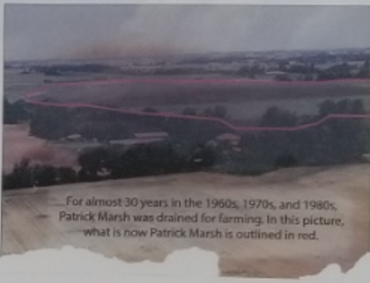

Slide 8
Patrick Marsh The History
The DOT was looking to replace wetlands destroyed in the expansion of Highway 151
Patrick Marsh was chosen as the State’s first wetland banking mitigation site
In 1991 the DOT purchased the land where Patrick Marsh used to exist
The DOT removed the drain tiles and disabled the pumps that drained the marsh and then transferred its 225 acres to the DNR to establish Patrick Marsh Wildlife Area

Slide 9
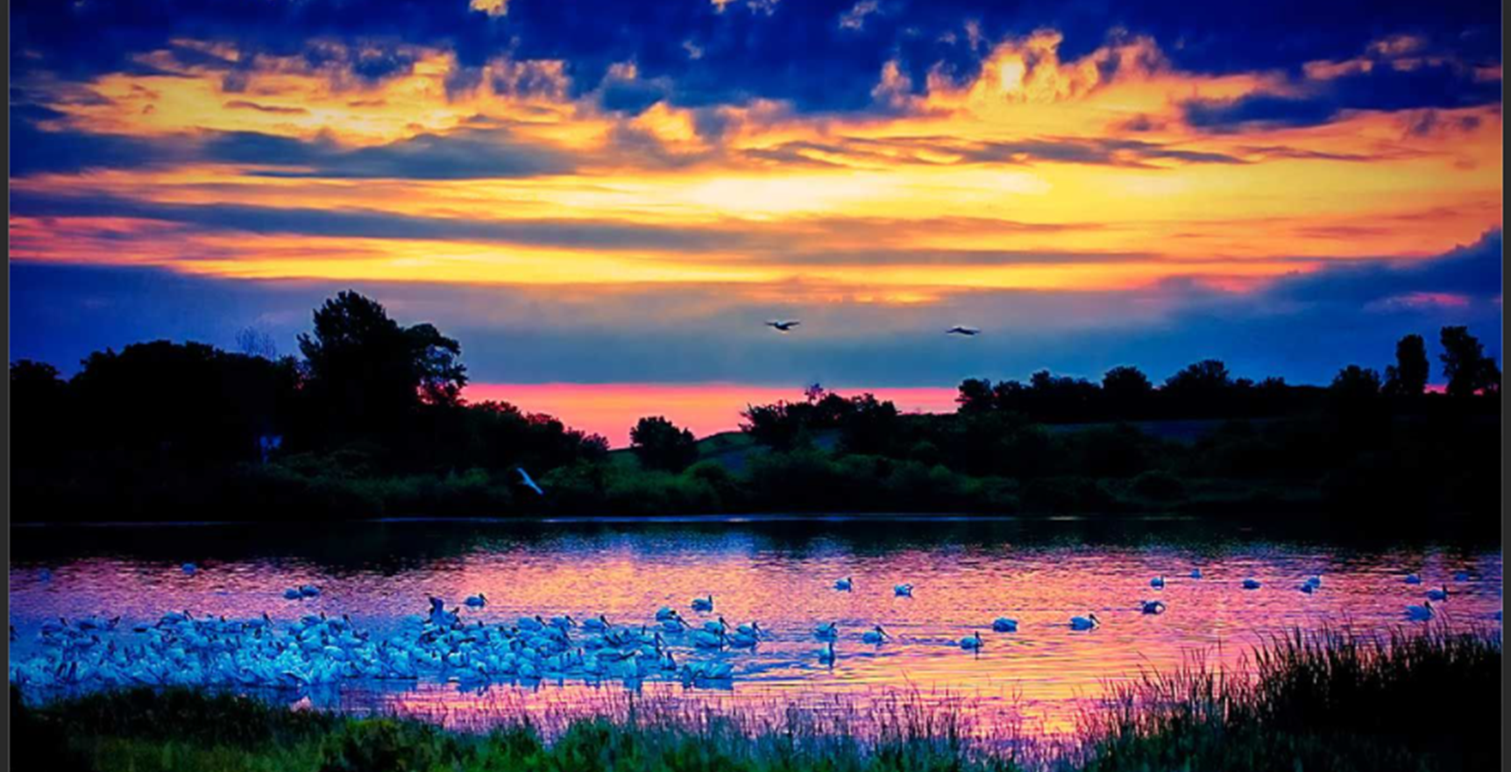
Patrick Marsh The History
In 1991, 100 acres of water appeared with an average depth of 18 inches
Thousands of ducks, geese and swans were observed that spring at the Patrick Marsh – the marsh was reborn

Slide 10
Surveyor’s Meander Corner at Patrick Marsh

Slide 11
Surveyor’s Meander Corner at Patrick Marsh
A meander corner is established at every point where a standard, township or section line intersects the bank of a navigable or meandered body of water.
A meander corner currently exists at Patrick Marsh Wildlife area
The current section corner is in the water at Patrick Marsh

Slide 12
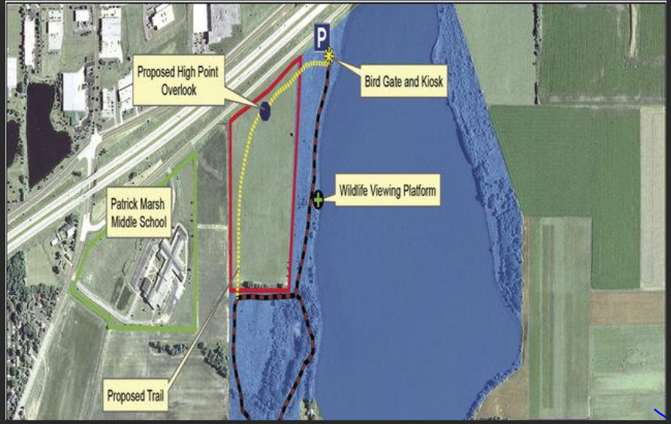

Slide 13
Wisconsin’s Original Point of Beginning

Slide 14
The Original Point of Beginning
After its establishment in 1832 nothing is known about the Initial Point of the 4th Principal Meridian until the mid-1960’s
Bill Wambach, a surveyor for the Wisconsin DOT became interested in searching for evidence of the point
In 1967, Bill and a group of other surveyors began searching for evidence of the point

Slide 15
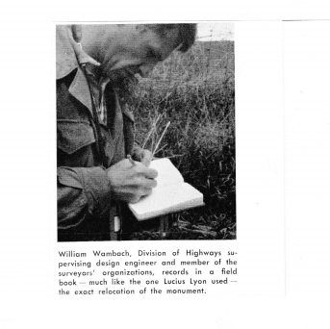
Finding the point of beginning

Slide 16
Patrick Marsh The History
In 1841 William T Patrick and his wife and four children came and settled here
Mr. Patrick took out at patent from the government for 125 acres of land on the Westshore of the lake which he called “Patrick Lake”
Patrick Marsh, a kettle lake, has a long history of going dry
Patrick Marsh has no natural inflow or outflow
In years of heavy snowmelt and rain, the marsh would swell and look like a lake

Slide 17
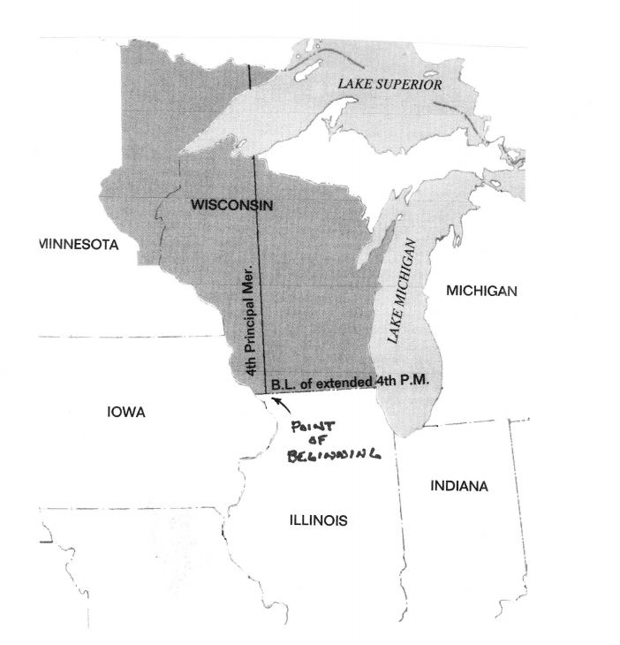
Original Point of Beginning
A narrow dirt road extends east along the State boundary from Illinois State Highway 84 and Wisconsin Highway 80
The Wambach group made a rather extensive “archaeological dig” around a fence post at the intersection of the east-west fence and the fence extending north along the meridian
They searched for evidence of the post and large mound built by Lucius Lyon on December 10, 1831

Slide 18
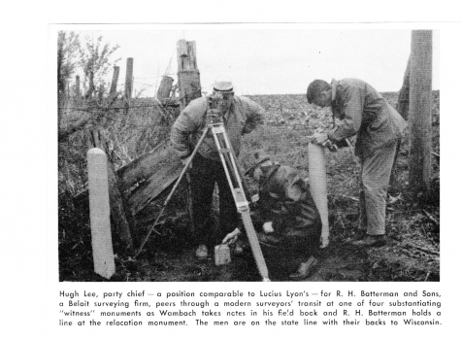

Slide 19
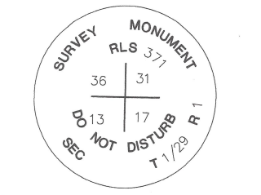
The Original Point of Beginning
Once the Original Point of Beginning was found
The initial Point was remonumented with a concrete post 4 feet long and 5 inches square, set about 42 inches into the ground with a brass cap embedded in the top
Dedication ceremonies were held on July 30, 1970

Slide 20
A roadside “Point Of Beginning” wooden sign was erected

Slide 21
Project Details

Slide 22
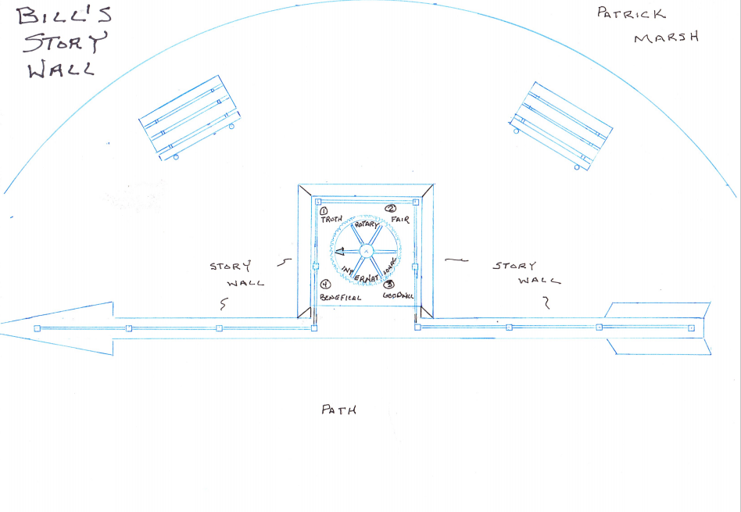

Slide 23
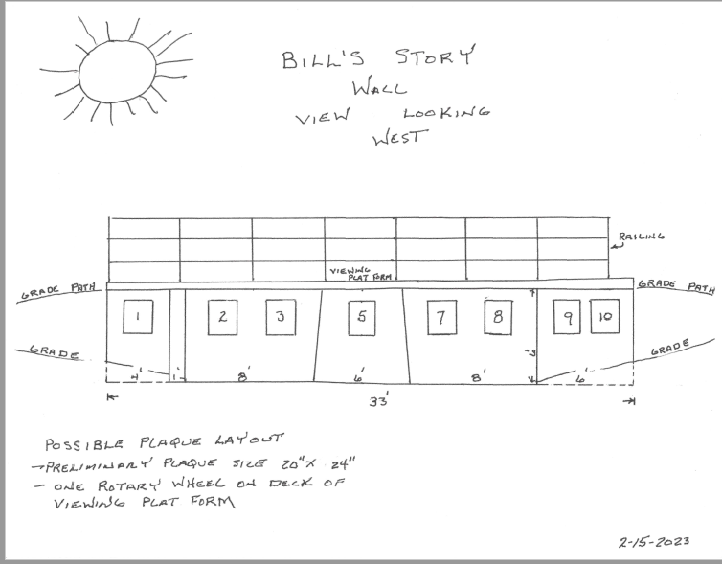

Slide 24
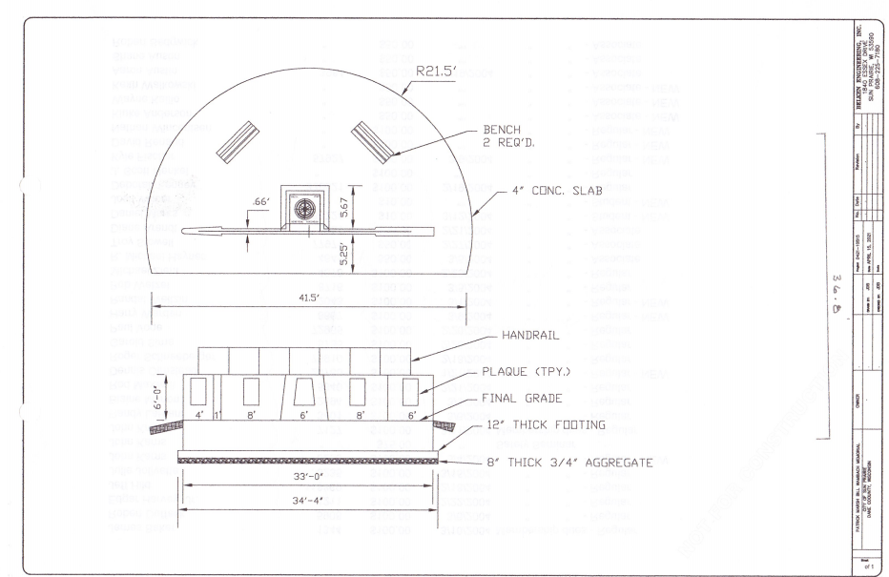

Slide 25
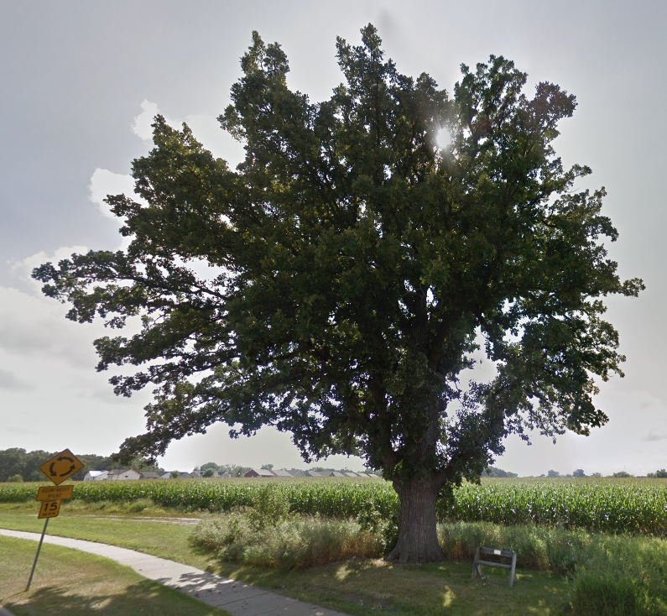
Bill’s Tree

Slide 26
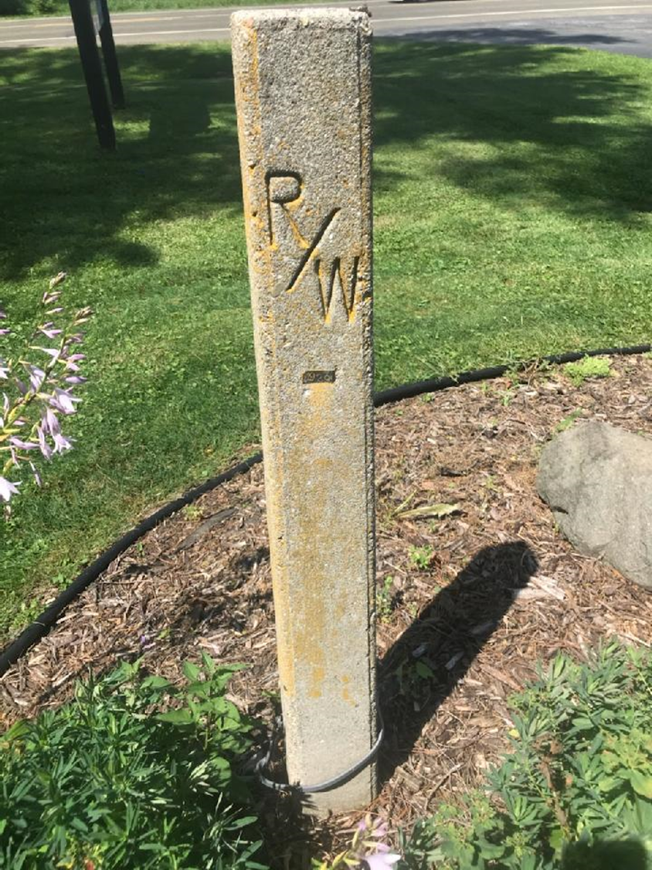
Bill’s 1929 r/w monument

Slide 27
Plaques for Site

Slide 28
Plaques for Story wall
Patrick Marsh History
Bill’s Story
Rotary and Patrick Marsh
Surveyor Story
Point of Beginning
Renk Family
Proclamation for Bill/Young Eagles
Supporters Names

Slide 29
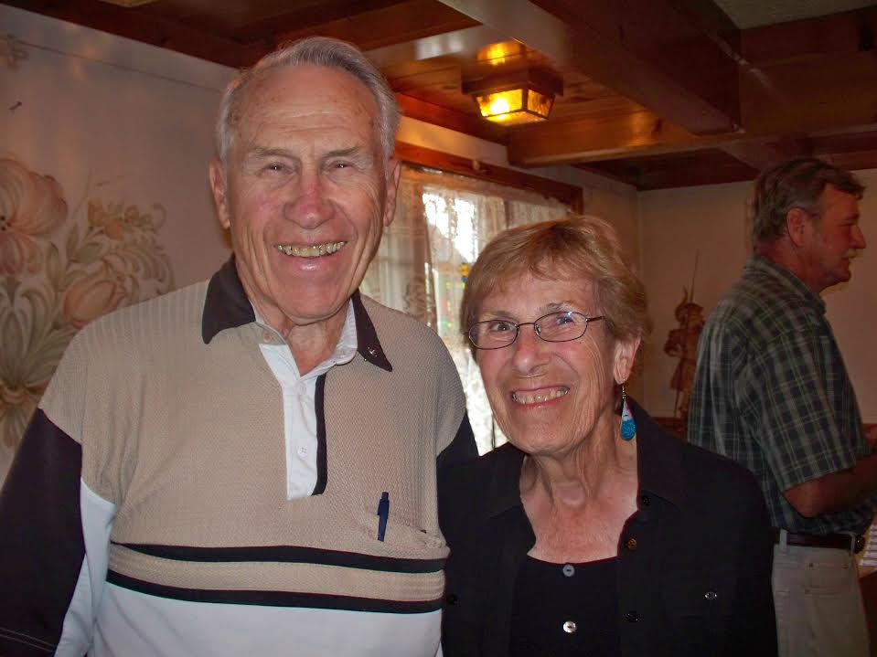
Example Plaque (with QR code for complete story)
This wall is a monument replicating the State of Wisconsin original Point of Beginning
From this point, all of Wisconsin was laid out and developed.
The wall is laid out as directional North Arrow, giving us directions.
William (Bill) Wambach, Professional Land Surveyor.
Land surveyors measure their projects everyday for all to use. This monument shows only a small part of Bill’s many life accomplishments.

Slide 30
Patrick Marsh Project & Support
The project will start in the late summer/fall 2023 and will be completed by April/May of 2024
Project Supporters
Groundswell Conservancy
City of Sun Prairie
Wisconsin Surveyors Association
Dane County Chapter of Surveyors
DNR
Sun Prairie Rotary

Slide 31
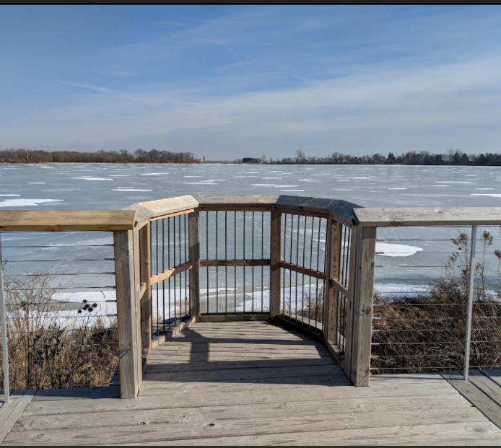
Project Funding
Total cost of project – approximately $75,000
Funds secured to-date
~$20,000
$10,000 grant from District 6250

Slide 32
Why
Sun Prairie has partnered with Groundswell Conservancy on several projects at the Marsh already
Bird viewing platform
The construction of two board walks in the marsh
Controlled burns
Planting of wildflowers
Clean up of invasive species
An educational component for the students of Sun Prairie, the community and Dane County
Destination point for visitors
Continued preservation of the land for wildlife
Adds another dimension of what Patrick Marsh has to offer

Slide 33
Why
Sun Prairie has partnered with Groundswell Conservancy on several projects at the Marsh already
Bird viewing platform
The construction of two board walks in the marsh
Controlled burns
Planting of wildflowers
Clean up of invasive species
An educational component for the students of Sun Prairie, the community and Dane County
Destination point for visitors
Continued preservation of the land for wildlife
Adds another dimension of what Patrick Marsh has to offer

Slide 34
Next Steps
Approval of the land exchange by the NRB (June 2023)
Permits obtained from Town of Bristol for construction
Green light from City of Sun Prairie and Groundswell to move forward with the project
Continued fund raising for the remainder of the project
Constructing the educational monument and viewing site

Slide 35
